Slide 1

Project Bundling
Saves Bundles!
(Version 12-December 22, 2021)
<College/University name>
<date>
<time>
<room location>
College/University Lecture
<presenter name>
<presenter title>
Notes:
Time: 0:30
Key message: Introduction slide, audience gathering slide
Delivery: lecture, read speaker notes below
Background Information: Sponsored by FHWA, an EDC-5 innovation initiative
Interaction: instructor introduction, confirm with audience the class they are attending
Photo sources and permissions to use: FHWA
NOTES to Instructor:
“Time” shown for each slide is a guide, total time is 50-minutes to fit into a typical class period.
Although 5-minutes are allocated for questions at the end of the lecture, you may prefer to take questions throughout the lecture to address students' inquiries timelier.
Good morning (or afternoon or both).
This is a class in Project Bundling, an Every Day Counts innovation initiative, sponsored by the Federal Highway Administration
This class includes a lecture and a bundling exercise based on the information in the lecture
Project Bundling seems like a simple concept, but we need to ask ourselves, “if it is so simple why have we not been doing it all along?”
And “why are we not doing it more now?“
When we look at the substantial benefits it brings, we should be doing it more often, or at least consider more strategically.

Slide 2
Disclaimer
This presentation was originally created by the Project Bundling Team at the Federal Highway Administration (FHWA). Its contents do not have the force and effect of law and are not meant to bind the public in any way. This presentation is intended only to provide information to the public regarding existing requirements under the law or agency policies.
The U.S. Government does not endorse products or manufacturers. Trademarks or manufacturers’ names appear in the original presentation only because they are considered essential to the objective of the presentation. They are included for informational purposes only and are not intended to reflect a preference, approval, or endorsement of any one product or entity.
Unless noted otherwise, FHWA is the source for all images in this presentation.

Slide 3
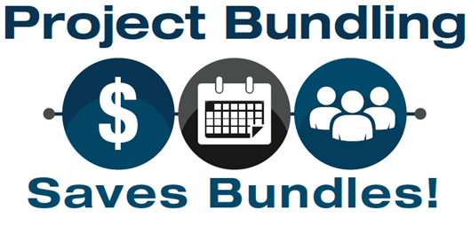
Agenda
What is project bundling?
Why project bundling?
How is project bundling done?
Examples/Case Studies.
Resources.
Notes:
Time: 0:30
Key message: Lecture agenda
Delivery: Explain agenda items, read instructor notes
Background Information: Sponsored by FHWA, an EDC-5 innovation initiative
Interaction: lecture
Photo sources and permissions to use: n/a
The agenda for this course follows these learning objectives and is based on answering the following questions:
What is project bundling?
Why should you consider Project Bundling?
If your agency wants to bundle projects, what steps would they follow? The how.
Examples using case studies.
Where can you get more help, i.e. what resources are available to you to create your project bundle, or bundling program?

Slide 4
Learning Objectives
Students should be able to:
Define project bundling (what) for public agencies (who).
Understand and define success for project bundling (why).
Describe how and when to create a project bundle.
Apply and evaluate project bundling.
Enumerate resources that are available for project bundling.
Notes:
Time: 1:30
Key message: Understanding of learning objectives
Delivery: Describe each learning objective, read instructor notes
Background Information: Sponsored by FHWA, an EDC-5 innovation initiative
Interaction: lecture
Photo sources and permissions to use: n/a
Although there are many learning objectives we could cover, this lecture will focus on these four.
We begin with gaining a complete understanding of the concept of project bundling – what is it.
Second, we will develop an understanding of why project bundling should be considered.
Third, we will learn the 10 steps necessary to create a successful project bundle; the how, for example,
There are almost limitless funding and finance options, and you don’t need to know many of them at this point—only the major ones, and we’ll go into those in some depth, and just mention the others.
We’ll review how to choose which projects to bundle—whether to bundle based on geographic proximity, project size, project type, funding, financing, etc.
The choice of delivery system is vital, and we’ll look at which systems offer the most practical advantages for different types of bundles.
Navigating the NEPA (National Environmental Protections Act) and environmental permitting processes are essential to a successful bundle.
The fourth learning objective is applying and evaluating project bundling by reviewing case studies and examples of actual project bundling projects.
The fifth learning objective Is to develop an understanding of the resources available to transportation infrastructure asset owners and those involved in project bundling contracts to create project bundles and to incorporate the practice into their business processes. This will include 25 practices an agency can evaluate to determine the maturity of their project bundling business processes.

Slide 5
Agenda item #1
What is project bundling?
Learning objective:
Define what is meant by project bundling.
Notes:
Time: 0:30
Key message: Begin agenda item #1, LO #1
Delivery: Read instructor notes
Background Information: Sponsored by FHWA, an EDC-5 innovation initiative
Interaction: lecture
Photo sources and permissions to use: n/a
Our first agenda item is “what is project bundling?”
Our first learning objective is to be able to define “what is meant by Project Bundling?” If we gain a really good understanding of this learning objective, the answer to the question in the Agenda item should begin to come into focus.
Bundling should become a concept with which you are all familiar. Even if you do not use it for construction projects, it is a good way to execute other agency products and procedures.

Slide 6
What is Project Bundling?
Project bundling is a process by which a single contract award is used to deliver multiple projects.
Traffic Bottlenecks
Bridge Deficiencies
Alternative Contracting
ADA Programs
Signing Updates
Reduced Staff Time
Safety Hot Spots
Smoother Pavements
High Risk Rural Roads
Funding Strategies
Innovation
Source: FHWA
Notes:
Time: 0:30
Key message: What is Project Bundling
Delivery: Read instructor notes
Background Information: See below
Interaction: lecture
Photo sources and permissions to use: FHWA, previously approved slide EDC-5
The concept of bundling has been around for some time. Different terms have been used to describe project bundling. For example, an INDOT July 2017 study was titled ‘capital program cost optimization through contract aggregation process.’
Other terms used include,
Consolidating
Grouping
Aggregating
Bundling packages or services (like home and auto insurance, like phone and internet services)
The Federal Transportation FAST Act specifically used “bridge bundling”
So, it is both old and new to transportation. We are going to introduce you to new approaches to project bundling, as well as a more strategic use of programmatic bundling versus project or initiative-based bundling.
A bundling contract could cover a single county, district, or State, and it may be tiered to allow a combination of work types (design, preservation, rehabilitation, or complete replacement). In some cases, the contract may include option years.
Bundling can be used for small and large projects.
The contract may be procured in several different ways and may include both design and construction in the overall scope, depending on the delivery method.
Project Bundling can be considered for all types of assets and can be combined with other innovations – such as with Alternative Contracting Methods (ACMs).
It may involve innovation, funding strategies, financing strategies, and value capture to address a variety of programs noted in this word cloud and much more.
------
----------
Instructor notes for reference -
Project bundling is a procurement process where a single contract is used for the rehabilitation or replacement of multiple projects.
Bundled contracts may also include the design and ongoing maintenance of those facilities.
Bundled contracts may be used a single county, metropolitan region or state and they may also be tiered to allow a combination of different types of work.
Bundling strategies achieve economies of scale and builds momentum to remediate critical facilities that are often in deficient condition.
Project bundling enables project sponsors to address large numbers of projects with similar needs using standard and cost effective rehabilitation and replacement strategies.
The resulting economies of scale increase efficiency and creates the potential for cost and time savings.
Larger bundled contracts may also attract private investors or larger and more experience contractors and help sponsoring agencies reduce project backlogs.
States and other project sponsors are using multiple funding sources and financing tools to pay for these larger contracts.
Asset bundling may be used with a wide range of projects including roads, traffic signals, fiber optic and broadband networks, travel plazas, alternative fuel stations, and parking facilities.
Given the large number of structurally deficient bridges across the country, contracts bundling bridge replacements and repair are increasingly common.
These bridges are often smaller, low-volume structures located in rural areas.
However, closures or limits on vehicle weights affect travel time, freight movements, and emergency response times adversely.
Smaller rural bridges often lend themselves well to bundling because standardized designs can be used for replacement structures.
-----
The FAST Act added a Bundling of Bridge Projects provision to “save costs and time by encouraging States to bundle multiple bridge projects as 1 project” (U.S. House of Representatives, 2015). The Congressional Budget Office (2012) cited the increased possibility of project bundling as one of the advantages of the private provision of highways.
Examples of large project bundling projects include MoDOT, PennDOT, Northampton Co. PA
Examples of small project bundling projects: Erie County, NY, Oakwood GA

Slide 7
Basis for Advanced Project Bundling
Use Cases
  Traditional / Specialty
  Initiative Based / Incidental
  Last Minute
  Catch-All
  Advanced / Optimized
Notes:
Time: 1:00
Key message: The Basis for Advanced Project Bundling – use cases
Delivery: Read instructor notes
Background Information: none
Interaction: lecture
Photo sources and permissions to use: n/a
Listed here are some Project Bundling categories or use cases. These are listed here mostly as an acknowledgment of what we have seen across the country and will be described in more detail in the following slides. The descriptive terms noted are not official, they are just terms that we have come with. While we’re recommending advanced or optimized project bundling, all of these categories of bundling can produce successful results.
------
Routine or traditional bundling has the following characteristics:
Generally, follow informal process or procedure.
Uses everyday available transportation funds (in other words –no specially designated program funds).
Some examples are maintenance/rehabilitation type activities and safety type projects.
-------
Initiative based or bundling that becomes incidental to an initiative or program.
Addresses a special need
Incidental to the availability of specially dedicated funds that need to be spend within a short time frame
Usually has a start date and an end date
Usually has a cap on the total funds available
Examples shown: Large numbers of bridges that needed to replaced within a short time frame. Shown is also the Competitive Highway Bridge Program of which Arizona was the recipient of an award (US 191 Bridge Bundling Project).
----------
Last Minute Bundling - These are projects that are bundled as a last-minute decision or opportunity:
Optionally tied projects available to contractors Contractor decides to bid a single or bundled project(s)
ER projects - task orders to bundle various damaged sites
Uses everyday transportation funds or ER funds
Examples: ER projects, Oklahoma and Iowa optional tied projects
------
Catch All Bundling:
Includes both horizontal and vertical construction
Serves as a one-stop shopping
Examples: Agencies with wide needs; May use CM/GC with a touch of JOC. Pueblo of Acoma Tribe and Pawnee Nation
-----
Advanced or Optimized Bundling:
This type of bundling is strategic, aligned with agency goals
Begins early in the planning process
Has well established and agency documented processes & procedures or business rules
Uses everyday transportation funds, not just for special programs or initiatives
Examples: Indiana & City of Oakwood Georgia
And of course, this type of bundling leads to successful results and is what we are promoting in EDC-5.

Slide 8
Agency Approaches to Bundling
How to Create a Bundled Project or Bundling Program
1. By Project
(or asset)
1a. Review Existing Program for Bundling Opportunities
1b. Program Bundles as a standard Business Practice
2. For an
Initiative
2a. Used to Support (or deliver) an initiative
2b. Used to justify (or make the case) for a special funded program
Source: FHWA
Notes:
Time: 1:00
Key message: How are agencies bundling
Delivery: Read instructor notes
Background Information: Quick Start Reference provides more detail
Interaction: lecture
Photo sources and permissions to use: FHWA, previously approved slide EDC-5
We see two main methods or process,
First it is individual project or asset based
we see this being done in two different ways - by reviewing your existing program for opportunities to bundle and save!
second as you conduct your asset management activities and identifying your needs, figuring out how you will meet your performance goals – you identify project locations by similar work types and program them as bundles project to take advantage of bundling efficiencies
Second method we see is by a major program or a special initiative; in this method there are also two different ways…
- first, bundling is used to deliver a special funded program or agency initiative (think ARRA)
- or second, bundled is used to justify, or, make the case for an initiative, to secure additional funding.
- this method applies to the need to get, a vast amount of work out in general. Not due to a special program or secure funding but just to get work off the books. As in, the owner has not been able to deliver what is needed for the community as fast as necessary to keep up with the needs of the community and to stimulate the economy and put the industry to work.
Both methods have their benefits – one benefiting individual projects by combining them together, a more strategic approach; the other approach is to achieve a specific initiative or make the case for one.

Slide 9
Agenda item #2
Why project bundling?
Learning objective:
Understand and define project bundling success (why).
Notes:
Time: 0:30
Key message: Begin agenda item #2, LO #2
Delivery: Read instructor notes
Background Information: Sponsored by FHWA, an EDC-5 innovation initiative
Interaction: lecture
Photo sources and permissions to use: n/a
Our second agenda item is “why project bundling?” Why agencies should consider it.
Our second learning objective is to be able to “Understand & define success for project bundling (why).”
If we gain a good understanding of this learning objective, the answer to the question in the Agenda item should begin to come into focus.
Bundling should become a concept with which you are all familiar. Even if you do not use it for construction projects, it is a good way to execute other agency products and procedures.

Slide 10
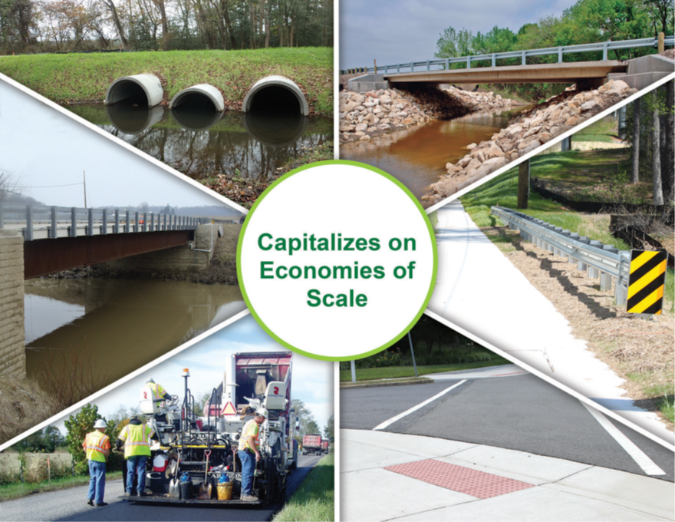



Why bundle?
Saves
Cost!
Capitalizes on Economies of Scale
Saves
Time!
Saves
Resources!
Source: FHWA
Notes:
Time: 0:30
Key message: Why consider Project Bundling
Delivery: Read instructor notes
Background Information: EDC5 Project Bundling website
Interaction: lecture
Photo sources and permissions to use: FHWA, previously approved slide EDC-5
Why Bundle? Can streamline environmental analysis & permits, design, contracting, and construction; allows agencies to capitalize on economies of scale to increase efficiency; and supports greater collaboration during project delivery and construction.
Reduced Cost. Bundling projects with shared features leverages design expertise and achieves economies of scale.
Expedited Project Delivery. Project bundling delivers strategic program solutions by streamlining various project delivery requirements such as environmental agreements and standardized designs.
Contracting Efficiency. Using a single contract award for several similar projects streamlines design and construction and saves procurement time. Bundling any projects together, improves contracting efficiency. However, bundling similar work is best whenever possible.
In addition, bundling can help agencies with limited staff by putting all projects together brings in professional staff under the bundling contracts, enabling the staff to oversee the design and construction vs having to individually manage each project.

Slide 11
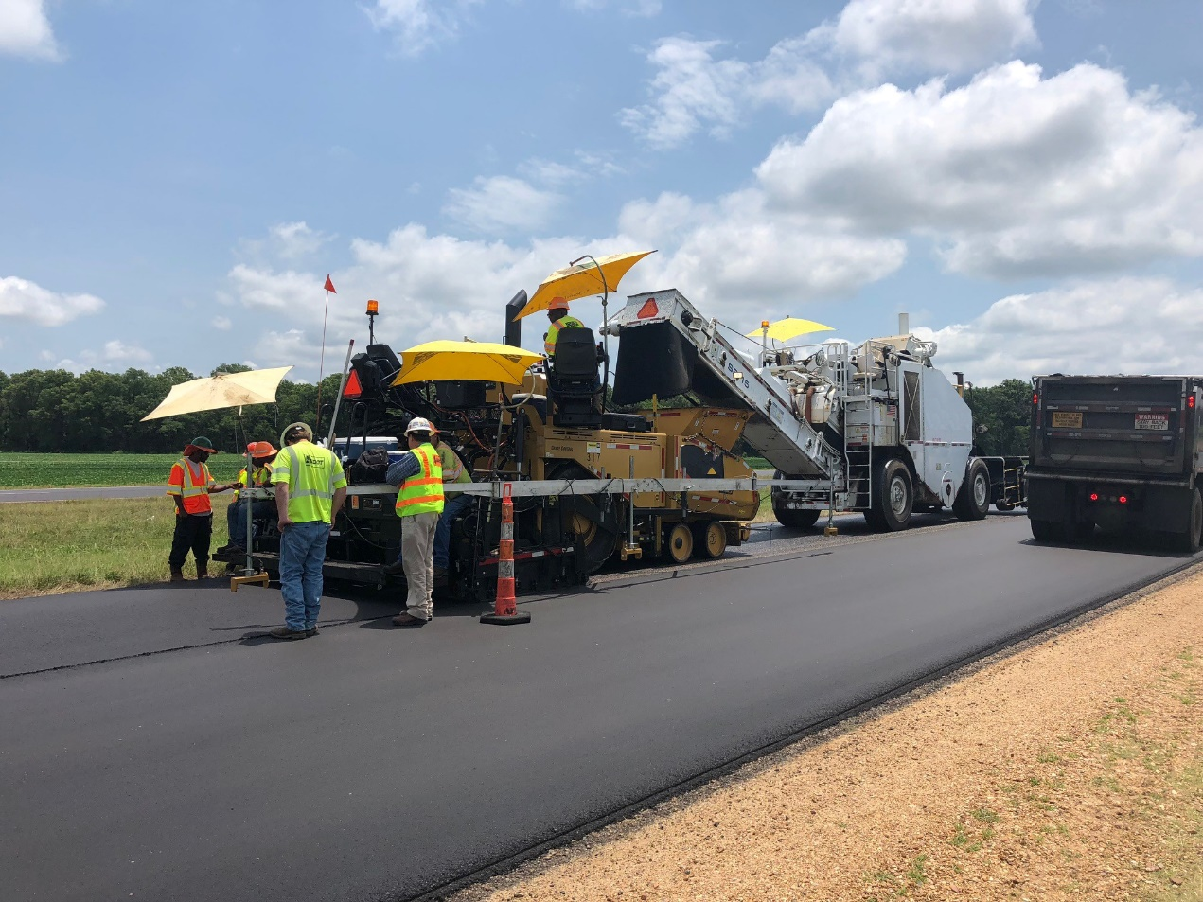
Why bundle projects?
Streamlines environmental analysis, design, contracting, and construction.
Allows agencies to capitalize on economies of scale to increase efficiency.
Improves quality through repetition.
Supports greater collaboration during project delivery and construction.
Source: National Asphalt Pavement Association
Notes:
Time: 1:00
Key message: WhyProject Bundling Delivery: Read instructor notes
Background Information: none
Interaction: lecture
Photo sources and permissions to use: National Asphalt Pavement Association
Project Bundling can help increase the performance of all three legs of the construction “stool,” time, cost, and quality.
It is intuitive that only having to do the paperwork for one contract will make that process go five times faster than for five individual projects.
Also intuitive to anyone with the most basic understanding of economics is that purchasing the necessary materials for five projects will get one a better price than if one is buying materials for a single project.
Finally, quality is enhanced, along with speed, as work crews perform the same projects over and over in five projects instead of for one.
And, of course, everything improves when the relationships between project personnel improve through familiarity; and improved relationships lead to improved collaboration.

Slide 12
Why is project bundling important?
US infrastructure in poor condition
  2021 American Society of Civil Engineers (ASCE) Report Card = C-
  Need more projects built faster.
Some agencies are short of funds and are looking for ways to save money.
  Can use economies of scale to pay less for each project than if they did each one individually.
Some agencies have funds that must be spent quickly, or they lose the funds.
  Need more projects built faster.
Notes:
Time: 1:00
Key message: Why is Project Bundling important
Delivery: Read instructor notes
Background Information: See below
Interaction: lecture
Photo sources and permissions to use: n/a
There are several reasons that Project Bundling is important.
First, the US infrastructure is in really bad shape, and money is scarce.
So, at the time when we most need to be fixing or replacing our roads and bridges, there is less money than ever by which to get it done.
Whether the goal is to get projects built faster, or to get projects built more efficiently and for less money, Project Bundling can be the answer, or at least an answer.
In those rare circumstances when an agency has money that must be spent quickly or lost, Project Bundling can be a godsend.
This sort of thing happens more often at the county or municipal level than at the state level but is sometimes a reality that must be dealt with.
Teaming Project Bundling with a fast and flexible delivery system such as CM/GC can sometimes make miracles happen.
A great example of bundling importance is its use by Tribal Nations across the country - they have experienced these types of miracles using bundling. As in, cutting 5-year Capital Improvement Plan down to 1 year and hitting some of the highest production rates in the nation, with extremely limited staffing. Things that were never possible prior to bundling.
-----
Background:
Source: Infrastructure Report Card: https://infrastructurereportcard.org/. Last accessed, 27 August 2021

Slide 13
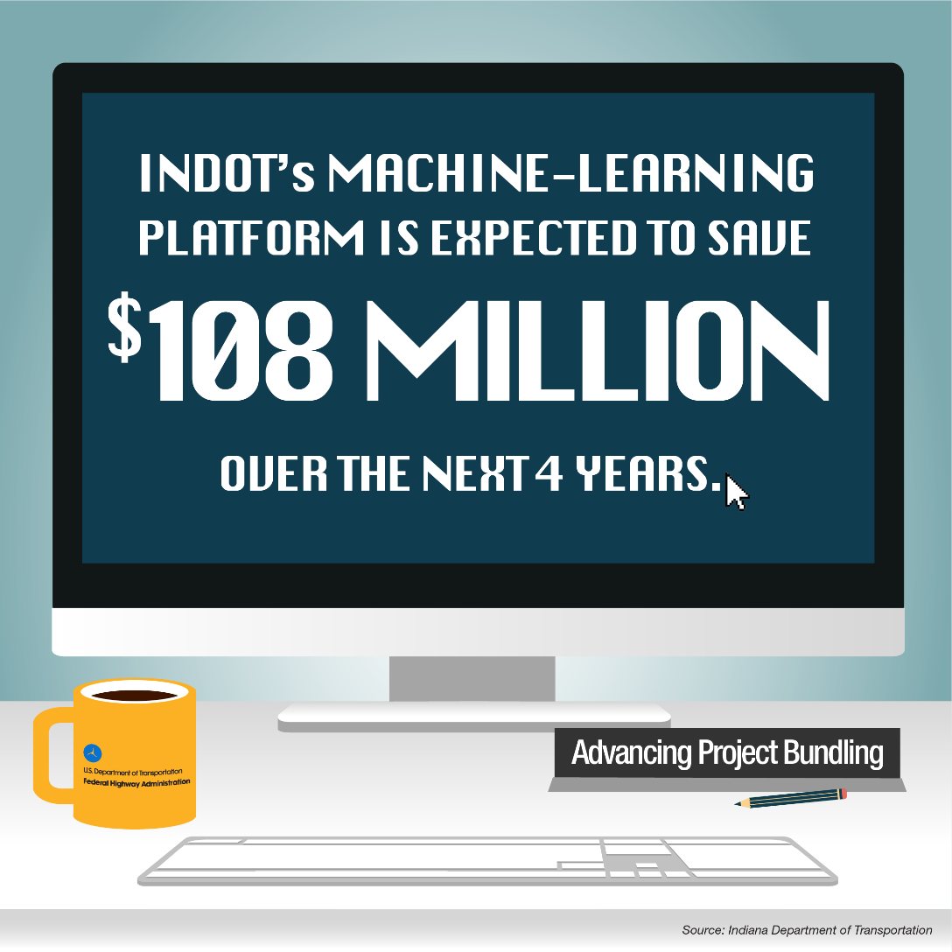
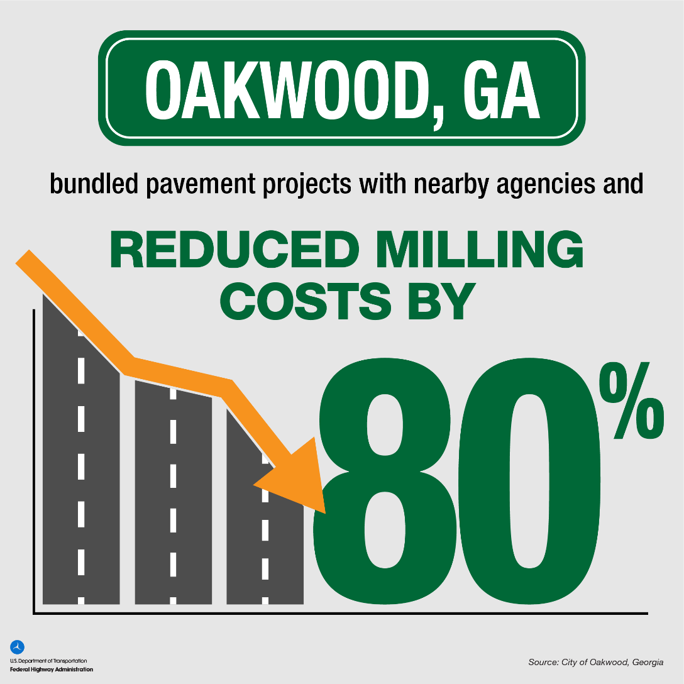
Savings
Oakwood, GA bundled pavement projects with nearby agencies and reduced milling costs by 80%
INDOT’S Machine-Learning Platform is expected to save $108 million over the next 4 years.
Source: Indiana Department of Transportation
Source: City of Oakwood, Georgia
Notes:
Time: 0:30
Key message: Why is Project Bundling – savings example
Delivery: Read instructor notes
Background Information: See below
Interaction: lecture
Photo sources and permissions to use: FHWA
Why do agencies bundle?
Here are two info graphics documenting savings realized by Indiana DOT and the City of Oakwood GA.
INDOT’s has used advanced project bundling, utilizing machine learning to help identify appropriate bundles to save an estimate $108 Million over 4-years; that translates into an addition $108 in additional projects that can now be constructed.
The City of Oakwood Georgia bundled with two other neighboring cities to significantly reduce their paving project costs.

Slide 14
More on why to bundle projects
A question of achieving agency goals & objectives.
Answer can be different for different agencies.
Must consider benefits listed earlier against costs.
  Political
  Necessary education/training
  Effort necessary in getting anything new “off the ground.”
  “We’ve never done this before.”
Notes:
Time: 0:30
Key message: More on why to bundle
Delivery: Read instructor notes
Background Information: none
Interaction: lecture
Photo sources and permissions to use: n/a
A different question than “Why should a project be part of a bundle?” - that will be discussed later.
This question is about standard operating procedure, tied back to an agency’s overall agency goals and objectives and how project bundling may help achieve them (the project bundling success definitions we just discussed).
An agency should consider the benefits and costs of project bundling and decide whether to join the many agencies that are turning to this innovation to help deliver their maintenance and capital program (environmental permitting, design, and construction).
The answer will not be the same for every agency, as each agency has goals related to their situation, no two agencies are the same, nor do any two face the same problems.

Slide 15
What is success for you? (1 of 2)
Speed? Getting several projects done quickly?
  Answer can be different for different agencies.
  Infrastructure needs are great.
  Political pressure to broadly improve asset conditions.
  Needs great and broad.
Cost savings?
  Repetition
  Less paperwork / smaller support staff
  Economies of scale
Notes:
Time: 1:00
Key message: Defining successful project bundling
Delivery: Read instructor notes
Background Information: Bridge Bundling Guidebook provides more detail
Interaction: lecture
Photo sources and permissions to use: n/a
Define Successful Project Bundling – what should the end state look like?
There are many different reasons to bundle. Hence, there are many different measures for success. The question is, “what do you need?”
Research shows that the four reasons most named for having done so, by agencies that have bundled, are related to speed, cost savings, efficiency, and quality.
There are many reasons for the need for speed. Sometimes an agency has funds with a due date by which the money must be spent or encumbered or the money is lost.
Sometimes, facilities are in such poor repair that they are unusable.
Sometimes important people want a thing built yesterday.
If the motivation is cost savings, research and experience have shown that repetition of work tasks is a boon to all four issues—speed, cost, efficiency, and quality.
Of course, as mentioned, the smaller support staff required, and economies of scale will result in cost savings.

Slide 16
What is success for you? (2 of 2)
Efficiency?
  Fewer staff resources needed
  Repetition.
Quality?
  Repetition
Other?
Notes:
Time: 1:00
Key message: Additional successful project bundling definitions
Delivery: Read instructor notes
Background Information: Bridge Bundling Guidebook provides more detail
Interaction: lecture, ask question
Photo sources and permissions to use: n/a
Success is defined for each project or program; some goals may include -
Efficiencies:
The fewer human resources needed the higher the efficiency – e.g., preparing one contract vs. several contracts is more efficient
Seeking approval internal and external for one contract is more efficient than for multiple contracts.
And then there is repetition, repetition, repetition – which leads to efficiencies and streamlined processes that should result in higher quality – the more you do an “activity” the better you become at it.
Quality:
Again, improved quality through repetition of work – the more you do the same type of work, the better you become at it.
Instructor: Go through bullets, ask the students what could some “other” success definitions include?
(For example, creating jobs/economic recovery, broad scale safety improvements, emergency response, collaboration with other agencies, etc.)
From Osceola County in Florida, “we needed all of these projects off the books to build / restore our credibility as a highway department”. Question is did we obtain this success and rapidly takes these projects off the books ahead of schedule and under budget?

Slide 17
Summary of Benefits and Considerations
BENEFITS | CONSIDERATIONS
Save costs (economies of scale). Coordinate NEPA approval. Expedite project delivery. Start construction earlier Coordinate construction staging. Reduce burden on agency staff. Use project delivery and procurement innovation. Apply technical/engineering innovation. Capitalize on funding and finance innovation. Benefit from local partnering-shared services. Increase construction workforce opportunities. Increase opportunities for small and disadvantaged businesses. | Finance costs. Mutual dependence. State procurement restrictions. Funding-annual program impact. Local industry capacity. Agency capacity. Federal fund use.
Notes:
Time: 1:30
Key message: Bundling Benefits and Considerations
Delivery: Read instructor notes
Background Information: See below
Interaction: lecture
Photo sources and permissions to use: FHWA, previously approved slide BBG.
This table summarizes the benefits and items to consider for bundling transportation infrastructure projects. Let’s discuss a few:
Bundling benefits can be much more than construction efficiencies, for example the idea of coordinating the NEPA and environmental permitting processes is an exciting opportunity to save time, money, and resources.
2. Agencies, or owners, working together. This can happen anywhere, but a common example is a small town or county with limited assets of one type, where traditionally they would improve one location at a time. What if they combined their project with one from a neighboring town or county, or with one at the state level – and shared the benefits, the efficiencies by bundling their projects? It can also assist with other departments working together. As in, a housing department may bundle projects with the roads department thereby gaining efficiencies and eliminating the need for both departments to each manage and contract their programs separately.
3. As for considerations, there are many. For example – are the work types being bundled similar enough to gain efficiencies? If not so similar, are they close together? Are they mutually dependent?
As an example of an advantage to bundling in construction . . . a contractor can work on a project until running into a delay, which under normal circumstances will result in inactive workers and equipment, and a claim for damages. When working on a bundle, if a contractor is delayed by, say, a utility company failing to honor its obligations to move a line, the contractor can simply move their crews and equipment to another project within the bundle, and continue working.
In some cases the distance apart may be a benefit. If jobs are spread out and logistically challenging, bundling can improve efficiencies in mobilizing out to these remote sites when normally, mobilization may be too expensive to warrant that project’s inclusion in the Work Plan.
-----
Background
Source: FHWA Bridge Bundling Guide, p. 19

Slide 18
Agenda item #3
How is project bundling done?
Learning objective:
Describe how and when to create a project bundle.
Notes:
Time: 0:15
Key message: Begin agenda item #3, LO #3
Delivery: Read instructor notes
Background Information: Sponsored by FHWA, an EDC-5 innovation initiative
Interaction: lecture
Photo sources and permissions to use: n/a
Our third agenda item is ‘how is project bundling done?”
Our corresponding third learning objective is that each of you should soon be able to describe how to create a project bundle.
There is a 10-step process that has been generated, based on data collected from research and analysis of case studies that we will discuss shortly.

Slide 19
Project Bundling Process
1
Define successful project bundling
Objective
2
Determine goals and objectives for the bundle
Identify funding or financing for the bundle
3
4
Build a coalition and outreach to inform and train about bundling
Tools
5
Perform risk assessment on proposed bundles
6
Select projects for bundle
7
Select delivery method for the bundle contract
Determine environmental review and preliminary design considerations for the proposed bundle
Outcome
8
9
Bundle & let contract(s)
10
Conduct quality assurance, close-out and celebrate
Notes:
Time: 2:00
Key message: Project Bundling Process
Delivery: Read instructor notes
Background Information: Bridge Bundling Guidebook and Advanced Project Bundling: A Reference for Getting Started provide more detail. Not every step will be covered in this lecture, for those not covered, or for more detail on each step, please see the BBG and QSR and other resources listed at the end of this lecture.
Interaction: lecture
Photo sources and permissions to use: FHWA, previously approved slide EDC-5
Bundling involves a 10-step process that includes steps that are not necessarily consecutive. Typically, it is an iterative process. the more successful programs tend to follow these 10 steps. Even if informally.
1. Deciding what success looks like in your specific situation is the first step.
2. Every bundling project starts with describing the project goals and objectives, an iterative process that is modified as detailed information becomes available.
3. Identifying potential funding sources or financing options (note there is a difference between funding and financing. Financing is the act of obtaining or furnishing money. Funding is money provided, especially by an organization or government, for a particular purpose. )
4. With the goals identified, a guiding coalition can be established, and a project manager selected.
5. Moving forward, the process is dependent on understanding the opportunities and threats to achieving the goals and objectives. An initial risk assessment should be conducted, resulting in a risk register that should be updated through the life of the project. Preparing a communication plan outlining stakeholder (internal and external) engagement is beneficial. Identifying the necessary or available funds (existing budgets, new Federal or State sources, or seeking private equity through a P3 arrangement) is obviously critical to placing a limit on the scope of work. Technical issues need to be addressed, including project selection criteria, design standards to be met, ROW to be procured, the environmental approval process, and third-party coordination.
6. A critical step is identifying projects that would fit together. Work types: recall the more similar the work types the more efficiencies you are likely to gain (ask why this is!)
7. Based on an updated risk analysis, a project delivery system (e.g., D-B-B, IDIQ, CM/GC, D-B, or P3) must be selected. An analysis of the different project delivery systems and selecting the most appropriate system to meet your project goals is essential. The procurement methodology also must be determined (low bid, best value, or QBS). Consideration should be given to incorporating the ATC process in the procurement. There are tools available to help agencies with selection appropriate project delivery methods – such as the FHWA CASE tool (Contracting Alternatives Suitability Evaluator) and the Colorado DOT’s PDSM (Project Delivery Selection Matrix).
8. Bundling environmental reviews, preliminary design, permitting actions can also be very beneficial. For example, seeking Section 106 approval for a group of bridge projects, is likely to be less effort than individual reviews.
9. Now, it’s time to go to construction. Let’s assemble our bundle and let the contract! How QA will be conducted, and civil rights requirements must be incorporated into the contract documents.
10. As the post-award activities commence and progress, an updated risk assessment can help an agency determine where its resources can best be used. Finally, closing-out the project and capturing lessons learned for future projects is vital to continuous improvement and optimization of the bundling program.

Slide 20
Introduction: Defining Success
Define successful project bundling
Objective:
1
2
Determine goals and objectives for the bundle
To be able to define a successful bundling project or program
Identify funding or financing for the bundle
3
4
Build a coalition and outreach to inform and train about bundling
Tools:
5
Perform risk assessment on proposed bundles
Definition
Case studies
List of lessons learned
6
Select projects for bundle
7
Select delivery method for the bundle contract
Outcome:
Determine environmental review and preliminary design considerations for the proposed bundle
8
Improved understanding of the range of successful bundling projects and programs
9
Bundle and let contract(s)
10
Conduct quality assurance, close-out and celebrate!
Notes:
Time: 0:30
Key message: Process step 1 – defining success
Delivery: Read instructor notes
Background Information: Bridge Bundling Guidebook provides more detail
Interaction: lecture
Photo sources and permissions to use: FHWA, previously approved slide EDC-5
Project bundling is a proven, effective way to both extend the life of fair- and good-condition highways and bridges, and to reduce the number of roads and bridges in poor condition, particularly when coupled with alternative contracting methods or a finance strategy.
This step involves you deciding in advance what outcome means success to you for your bundle (i.e., to your organization).
Defining success for a project bundle should be consistently understood from the project manger to agency leadership to stakeholders. This assures that different perspectives and program requirements are met.
Agenda item #3 will go into more detail and provide case studies of successful bundled projects.

Slide 21
Potential Success Indicators
Achieving performance targets.
Completing preservation/preventive maintenance actions.
Rehabilitating assets.
Replacing assets.
Achieving economies of scale.
Reducing cost.
Accelerating project schedules.
Deploying innovation.
Notes:
Time: 0:30
Key message: Potential Success Indicators
Delivery: Read instructor notes
Background Information: Bridge Bundling Guidebook provides more detail
Interaction: lecture
Photo sources and permissions to use: n/a
This slide provides examples of potential indicators of project bundling success.
In summary, project bundling is a proven, effective way to both extend the life of fair- and good-condition assets and to reduce the number of assets in poor condition, particularly when coupled with Alternative Contracting Methods or a finance strategy.
It can be used for all types of projects, including preservation and preventive maintenance, rehabilitations, and replacement.
This will be demonstrated later in the presentation using several case studies as part of learning objective #3.

Slide 22
Goals and Objectives
Objective:
1
Define successful project bundling
Determine goals and objectives for the bundle
To establish goals and objectives for a bundling project or program
2
3
Identify funding or financing for the bundle
4
Build a coalition and outreach to inform and train about bundling
Tools:
5
Perform risk assessment on proposed bundles
Case studies
List of common goals, benefits, and objectives
Work types
6
Select projects for bundle
7
Select delivery method for the bundle contract
Determine environmental review and preliminary design considerations for the proposed bundle
8
Outcome:
9
Bundle and let contract(s)
Documented project goals and objectives
10
Conduct quality assurance, close-out and celebrate!
Notes:
Time: 1:30
Key message: Process step 2 – Determine goals & objectives for the bundle
Delivery: Read instructor notes
Background Information: Bridge Bundling Guidebook provides more detail
Interaction: lecture, ask students for potential goals and objectives (see below for potential responses or items to start the conversation)
Photo sources and permissions to use: FHWA, previously approved slide EDC-5
Step 2:
An important first step toward taking advantage of bundling’s benefits is establishing the bundling goals and objectives of the project or program. (in addition to other project goals).
Without clearly defined goals and objectives, subsequent steps will be difficult or impossible.
As the project or program progresses, there may be a need to reevaluate or refine the goals and objectives—this iterative process is common.
This step in the process should result in a documented list of goals and objectives to share with the project bundling team and stakeholders.
This process should work the same whether for repair, rehabilitation, or replacement.
Both the benefits and challenges of project bundling will depend on an agency’s goals.
Benefits may include:
Improving asset management,
saving money,
expediting project delivery,
coordinating construction staging, and/or reducing the workload of agency staff.
Challenges that may need to be addressed include:
finance costs,
state contracting and procurement restrictions,
meeting Federal requirements if Federal funds are used, and
the capacity of local industry to keep up with the size and pace of large bundles.
[Instructor: Ask students for potential goals and objectives]
Note to the students - To be truly effective, goals need to be measurable and then they need to be tracked. Saying we want a successful project is near worthless but saying we want a project to come in 20% under budget and with zero change orders and delays means something. In other words, actual goals will have detail and they will be “SMART” (Specific, Measurable, Attainable, Relevant, and Time-Bound)
[Instructor: Do not take the time to read the lists below. They can be used as examples to get the discussion started, or to help the students understand the kind of thing we’re looking for]
Some possible goals and objectives . . . your bundle project may have one or more of these . . . Achieve performance goals
Save time
Save design costs
Save construction costs
Take advantage of economies of scale
Take advantage of available funding
Take advantage of financing
Deploy innovation
Expedite project delivery
Utilize alternative contracting methods
Coordinate construction staging – reduce public disruption
Start construction of multiple bridges simultaneously
Maintain bridges in good and fair condition
Improve bridges in fair condition to good condition
Reduce bridges in poor condition
Improve locally owned bridge conditions
Improve surrounding land value, economic benefits
Partner with other agencies to achieve efficiencies
Create jobs in the construction industry
Increase pool of bridge contractors in a geographic area
Create opportunities for small and disadvantaged businesses
Create on-the-job training opportunities

Slide 23
Potential Goals and Objectives (1 of 2)
Achieve national goals and performance management measures.
Address transportation asset management plan objectives.
Save time—accelerate work that would not advance as rapidly with traditional methods.
Save design costs.
Save construction costs.
Take advantage of economies of scale—improve production.
Maximize use of available funding.
Take advantage of financing.
Deploy innovation.
Notes:
Time: 0:30
Key message: Potential bundling goals and objectives
Delivery: Reference list on slide – do not read list; read instructor notes
Background Information: Bridge Bundling Guidebook provides more detail
Interaction: lecture
Photo sources and permissions to use: n/a
Public agencies create bundled projects because of the benefits that can be realized through the process.
For some agencies, bundling may be beneficial because of a need to address preservation/preventive maintenance of assets in good and fair condition or to reduce assets in poor condition quickly.
For other agencies, it may be due to insufficient staff, a sudden increase in funding, or an obligation deadline, or it may be to address a critical corridor or leverage other funding and financing strategies.
For nearly all agencies', increased efficiency is the primary reason for bundling—increased efficiency in planning, project management, design, procurement, and construction.
A DOT, LPA, or other highway asset owner can use bundling to achieve one or more goals; some of the common goals, not listed in any order, are shown on this slide.

Slide 24
Potential Goals and Objectives (2 of 2)
Expedite project delivery—achieve public improvements sooner.
Utilize ACMs.
Coordinate construction staging—reduce public disruption.
Start construction of multiple bridges simultaneously.
Maintain and improve bridge condition.
Improve surrounding land value and economic benefits.
Partner with other agencies to achieve efficiencies.
Create jobs in the construction industry.
Increase pool of bridge contractors in a geographic area.
Create opportunities for small and disadvantaged businesses.
Create on-the-job training opportunities.
Notes:
Time: 0:30
Key message: Additional potential bundling goals and objectives
Delivery: Reference list on slide – do not read list; read instructor notes
Background Information: Bridge Bundling Guidebook provides more detail
Interaction: lecture
Photo sources and permissions to use: n/a
…and the list of potential bundled project goals and objectives continues on this slide.
As you tell there are many reasons, or objectives, why an agency could consider bundling.
And this list is by no means inclusive.
(Ask students if they can think of other reasons why bundling could be considered.)

Slide 25
Coalition Building and Outreach
1
Define successful project bundling
Objective:
2
Determine goals and objectives for the bundle
To identify a project implementation team and develop an internal and external outreach plan
3
Identify funding or financing for the bundle
4
Build a coalition and outreach
Tools:
5
Perform risk assessment on proposed bundles
Example communication plan
Tables of communication topics
6
Select projects for bundle
7
Select delivery method for the bundle contract
Determine environmental review and preliminary design considerations for the proposed bundle
Outcome:
8
Communication plan
9
Bundle and let contract(s)
10
Conduct quality assurance, close-out and celebrate
Notes:
Time: 1:00
Key message: Process step 4 – Build a coalition & outreach
Delivery: Read instructor notes
Background Information: Bridge Bundling Guidebook provides more detail
Interaction: lecture
Photo sources and permissions to use: FHWA, previously approved slide EDC-5
Step 3 in the process – “identifying funding or financing for the bundle” is not covered in this lecture, because this step must be taken with any project—and there are many options. I do encourage you to read this chapter in the Bridge Bundling Guidebook, as it provides a great overview of all the options to be considered. Without funding all else is an exercise in futility. No funding, can equal no program.
Step 4:
Building an internal coalition – a group of subject matter experts to advise and better ensure all issues are addressed - is key.
Public agencies should also engage stakeholders early in the process to gain support for a bundled project or program (external coalition).
This may include outreach to internal organizations, and external organizations such as elected officials, construction industry, design industry, other stakeholders, and the public.
Outreach may involve anything from simple notification to intense training.
A documented communication plan that describes the specific organizations needed for project support and those affected by it, as well as the recommended content, type, methods, and frequency of communication, should be prepared during this step in the project bundling process.
A communication plan can be developed that describes the specific organizations needed for:
Support of an agency’s bundling project and those affected by it
Recommended content, type,
Methods, and frequency of communication.
This tool will enable the project team to quickly see and understand the groups involved, who is responsible for communication, and how communication should be conducted.
Step 5 on risk management is described in detail in the BBG and appendix and other resources listed at the end of this presentation – this step can be its own course, encourage everyone if not familiar with risk management to learn more about this process.

Slide 26
Project Selection
1
Define successful project bundling
Objective:
2
Determine goals and objectives for the bundle
To identify a project selection criteria and candidate projects
3
Identify funding or financing for the bundle
4
Build a coalition and outreach
Tools:
5
Perform risk assessment on proposed bundles
Selection matrix
Table of contract sizes
Table of contract durations
Select projects for bundle
6
7
Select delivery method for the bundle contract
Determine environmental review and preliminary design considerations for the proposed bundle
Outcome:
8
List of candidate bridges for bundling
9
Bundle and let contract(s)
10
Conduct quality assurance, close-out and celebrate
Notes:
Time: 0:30
Key message: Process step 6 – Select projects for bundle
Delivery: Read instructor notes
Background Information: Bridge Bundling Guidebook provides more detail
Interaction: lecture
Photo sources and permissions to use: FHWA, previously approved slide EDC-5
Step 6 – selecting projects to be included in a bundle
Once a public agency has decided to bundle projects and has established desired project bundle goals, it will then decide the size of the bundle project.
There is no one-size-fits-all approach to project bundling.
The size of a bridge bundle can vary widely depending on goals, funding or financing available, agency capacity, timeframe, and availability of contractors to construct the bundle project.
Bundling contracts prepared by agencies have ranged from 2 to 558 locations.
Agencies can identify candidate projects for bundling by employing selection criteria that meet specific project or program goals while considering an agency’s risk analysis.
These criteria include industry capacity, project timeframe, environmental permitting, utilities and ROW, bridge size, and geographic location and proximity.
Tools to assist in identifying candidates for bundling include a selection matrix, ranges of contract sizes and contract durations, and a table of potential screening criteria – we will discuss these next.

Slide 27
Why should a project be part of a bundle?
Goal: NOT to “bundle as many projects as we can.”
  Goal is to be strategic, to achieve an agency objective.
Goal: find projects that will . . .
  become more efficient within a bundle.
  make the other projects in a bundle more efficient.
  become more attractive to bidders if it is part of a bundle.
Notes:
Time: 0:30
Key message: Why should a project be part of a bundle
Delivery: Read instructor notes
Background Information: Bridge Bundling Guidebook provides more detail
Interaction: lecture
Photo sources and permissions to use: n/a
An agency should never create a project bundle just to say they did. Goal is certainly not to find a bundle for every project in the work program
A project bundle should be strategic. Think “bundle to solve an organization’s problem”
The goal is NOT to make as many bundles as we can. Nor is it to bundle as many projects as we can.
The key questions are:
Will placing this project in a bundle make this project more efficient?
Will placing this project in a bundle make the other projects in the bundle more efficient?
Will placing this project in a bundle make this project more attractive to more bidders? In other words, will more bidders be interested in bidding on this project as a stand-alone project, or as part of a bundle?
Note, there’s exceptions to every rule. As in, oftentimes a problematic project can be added to an otherwise text book bundling package in order to use the power of the team and the efficiencies in the other bundled projects to get it designed and constructed. One example is a project that costs more to mobilize than the work itself. This would be a good one include in the bundle because the other projects can buffer the mobilization.

Slide 28
Project Selection (1 of 2)
Geographic Location / Proximity
Similar Road Type
Similar Bridge Size
Similar Bridge Type
Notes:
Time: 1:00
Key message: Project selection criteria
Delivery: Read instructor notes
Background Information: Bridge Bundling Guidebook provides more detail
Interaction: lecture
Photo sources and permissions to use: n/a
One of the more obvious considerations is geographic proximity. This certainly offers many advantages for those wishing to bundle projects, but it is far from the only consideration. Many successful bundles have been forged without this characteristic, as long as getting from one project to another is not too onerous, or distant locations are not scheduled to be worked on at the same time.
Similar project size and project type can also be ties that bind projects together into successful bundles. Let’s look at these points individually.
Geographic Location / Proximity
Can reduce Mobilization costs
Can reduce Inspection costs
Similar Road Type
Can result in construction efficiencies through task repetition and similar work zone control setup
Similar Bridge Size
Reduces complications
Similar Bridge Type
Also increases efficiency through repetition and reduces complications
Less need for different designs and construction means and methods

Slide 29
Project Selection (2 of 2)
Similar Work Types
Funding
National Environmental Policy Act¹ (NEPA) process and environmental permitting
¹42 U.S.C. §4321 et seq. (1969)
Notes:
Time: 1:00
Key message: Additional project selection criteria
Delivery: Read instructor notes
Background Information: Bridge Bundling Guidebook provides more detail
Interaction: lecture
Photo sources and permissions to use: n/a
Narrowing the focus enables one to consider a work type (preservation, rehabilitation, replacement/new) within a project type (e.g., pavement, bridge, safety).
Examples of this would be:
Preservation of bridges
Preservation of roads
Rehabilitation of bridges
Rehabilitation of roads
Replacement of bridges
Replacement of roads
Expansion of bridges
Expansion of roads
Please note that the factors on the last two slides do not comprise an exhaustive list.
Funding can also serve as the basis for successful bundling.
If projects within an agency’s Work Plan are funded by several different sources, it might prove convenient to bundle projects being funded by the same source.
Also, if some of the projects in a work plan are funded, and some are not, it can be prudent to go ahead with the funded projects as a bundle, and do the others later as a second bundle, or individually.
Another foundation on which to build a bundle is the twin processes of NEPA and the Environmental Permitting.
These processes can be time consuming and complicated, the prospect of addressing for several projects all at once can prove to be strong incentive to bundle projects.
Any of these reasons to bundle projects are good reasons. Each can theoretically add efficiency to the contracting and construction processes, and these are the overriding goals of project bundling.
While Bundling has been shown to be at its most effective if the projects in the bundle are all of the same type, even this is not essential.
The idea of bundling road projects with bridge projects should not be dismissed out of hand, if doing so would help solve a problem for the agency.
Neither should the idea of bundling rehabilitation projects with replacement projects, or expansion projects be dismissed out of hand, if doing so would help solve a problem for the agency.
New construction projects can also be successfully bundled.
Indian Tribes have even been very successful bundling vertical and horizontal projects, new and not-new, in the same contract.
Again, there are exceptions to every rule. One exception may be a local agency include both funded and unfunded. Reason being the team can get it shovel ready which oftentimes makes it eligible for funding and gives the PB team something to target once all of the other projects are completed. On the tribal note, well said, consider adding: funded and not funded, logistically challenging, projects without enough budget needing the savings from other projects, etc.

Slide 30
Select Delivery Method
1
Define successful project bundling
Objective:
2
Determine goals and objectives for the bundle
To identify the most appropriate project delivery and procurement method
Identify funding or financing for the bundle
3
4
Build a coalition and outreach to inform and train about bundling
Tools:
5
Perform risk assessment on proposed bundles
Comparison tables of project delivery & procurement methods
6
Select projects for bundle
Select delivery method for bundle contract
7
8
Determine environmental review and preliminary design considerations for the proposed bundle
Outcome:
9
Bundle and let contract(s)
Selected project delivery & procurement method
10
Conduct quality assurance, close-out and celebrate
Notes:
Time: 0:30
Key message: Process step 7– select project delivery method
Delivery: Read instructor notes
Background Information: Bridge Bundling Guidebook provides more detail
Interaction: ask students to describe different project delivery methods (to see what the now), lecture
Photo sources and permissions to use: FHWA, previously approved slide EDC-5
Due to time constraints, the last step we are going to cover in this lecture is step 7 – selecting a delivery method.
Steps 8-10 – environmental review, preliminary design, contract letting process, and quality assurance, project close-out, and celebrating your successes are detailed in the BBG.
Ask students to list different project delivery methods to gauge their understanding (e.g. D-B-B, IDIQ, CM/GC, D-B, PDB, P3).
Step 7:
All project delivery methods have been used successfully for project bundling. Success is often determined by selecting an appropriate delivery method for that bundle. Most common are design-bid build (D-B-B), Indefinite Delivery Indefinite Quantity (IDIQ), and design-build (D-B) project delivery methods
Another ACM that seems tailor-made for Project Bundling and is proving useful for agencies in delivering project-bundled contracts is CM/GC.
There have also been large scale public private partnership (P3s) used to deliver bundling programs.
Understanding the different project delivery and procurement methods that are available, and the benefits and disadvantages of each, will help agencies to select the most appropriate methods to meet goals and objectives.
Helpful tools include tables that readily show the strengths, weaknesses and characteristics of all candidate delivery systems and procurement methods.
Many factors will come into play in making this determination, for example, the funding or financing strategy and risk analysis will provide critical input into the decision. There have been several good tools developed that are available to assist agencies in selecting a delivery method.
There are tools available to help agencies with selection appropriate project delivery methods – such as the FHWA’s CASE tool (Contracting Alternatives Suitability Evaluator) and the Colorado DOT’s PDSM (Project Delivery Selection Matrix).
This is the last step that will be highlighted. The steps not highlighted in this presentation were not highlighted because they are steps that must be taken for any project in much the same manner as they would e taken in a bundling project.

Slide 31
Delivery Systems and Bundling
Project bundling works with any delivery system
Design-bid-build (D-B-B)
Construction manager / General contractor (CM/GC)
Design-build (D-B)
Public private partnership (P3)
Notes:
Time: 0:30
Key message: Project delivery methods
Delivery: Read instructor notes
Background Information: Bridge Bundling Guidebook provides more detail
Interaction: lecture
Photo sources and permissions to use: n/a
The good news is that Project Bundling works with any Project Delivery Method
D-B-B stays popular as most people understand it, has a long history, and well-defined roles.
CM/GC is relatively new and is gaining approval from owners.
The benefits are documented in an FHWA TechBrief, “Alternative Contracting Method Performance in U.S. Highway Construction” (FHWA-HRT-17-100), which shows CM/GC is outperforming both D-B-B and D-B in cost and schedule savings.
CM/GC is not only a good tool for replacement bundles, but it can also be very effective for bundling rehabilitation projects, where the complete scope of the work is often undefined.
CM/GC is the only delivery system that has accommodated different types of vertical construction and different types of horizontal construction under the same bundled contract.
CM/GC is the only delivery system that requires no criteria or prescribed drawings or special provisions from the owner prior to letting.
CM/GC’s been used successfully with 6 Federal Bundling Pilots.
Design-Build has proven very effective for bundling, provides more contractor flexibility than D-B-B
Public-Private-Partnerships offer the advantage of outside funding; projects are typically delivered using D-B under the P3 concessionaire direction – therefore has the same advantages and disadvantages as D-B

Slide 32
Project Delivery Methods
Bundling projects, depending on the agencies’ governing laws, may allow for use of innovative project delivery methods such as Construction Manager/General Contractor (CM/GC), Design-Build (D-B), and Public-Private Partnerships (P3) and procurement methods such as best value and qualifications-based selection.
Traditional
Alternate Project Delivery and Contracting Methods
Agency
Designer
General Contractor
Agency
Independent Cost Estimator
Designer
Construction Manager/General Contractor
Agency
Designer(s)
General Contractor(s)
Design-Builder
Agency
Concessionaire
Design- Builder
Lender
Design-Bid-Build & IDIQ
CM/GC
Design-Build
P3
Source: FHWA
Notes:
Time: 0:45
Key message: Project delivery methods
Delivery: Read instructor notes
Background Information: Bridge Bundling Guidebook provides more detail
Interaction: lecture, pause
Photo sources and permissions to use: FHWA, previously approved slide BBG.
These are organization charts for the four most-used construction project delivery systems:
D-B-B,
Indefinite Delivery/Indefinite Quantity (IDIQ),
CM/GC
D-B,
P3s (DBFOMT).
IDIQ project delivery (aka job order contracting, aka open-end contracts, aka push-button contracts) has been used effectively for years for bundling preservation and maintenance projects of all sorts.
Instructor: Pause for a few seconds to let the class take in the diagram.

Slide 33
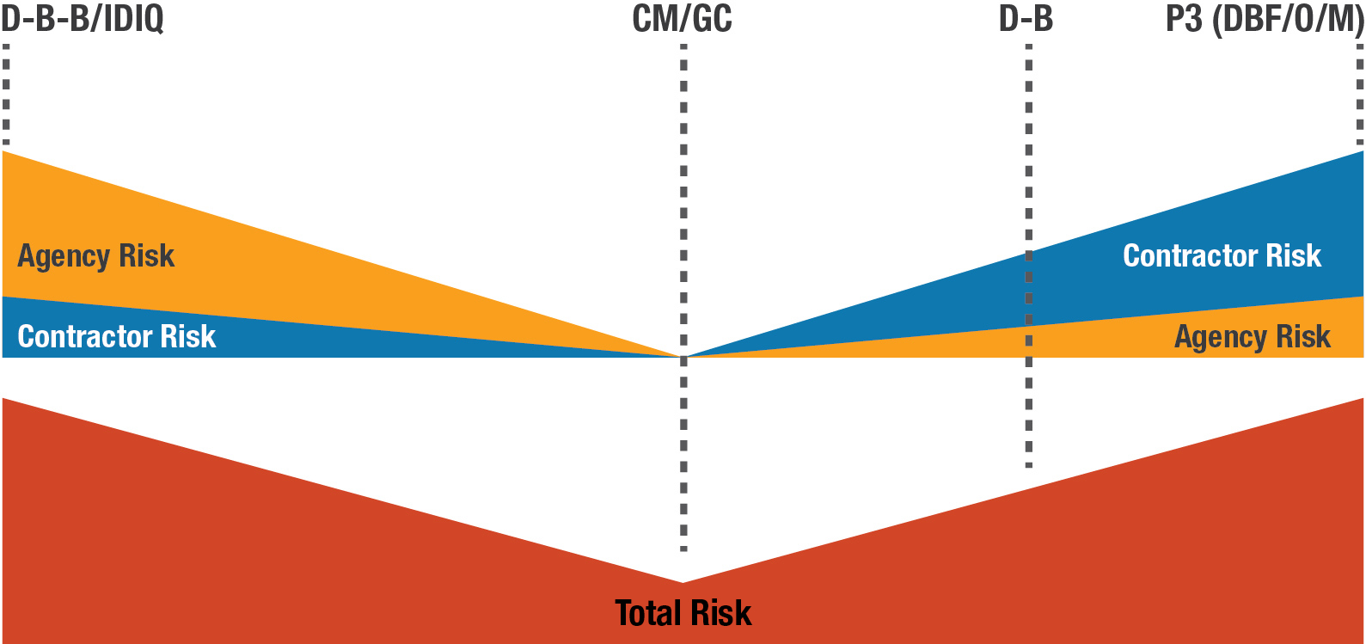
Risk Allocation and Management
by Project Delivery Method
Source: FHWA
Notes:
Time: 0:45
Key message: Risk allocation by project delivery method
Delivery: Read instructor notes
Background Information: Bridge Bundling Guidebook provides more detail
Interaction: lecture, pause
Photo sources and permissions to use: FHWA, previously approved slide BBG.
Time: 0:45.
Photo sources and permissions to use: FHWA, previously approved slide BBG.
The different project delivery methods at their basic level are nothing more than different ways to allocate and manage risk among the different parties.
Conducting a risk assessment (Step 5) is critical to determining the most appropriate project delivery method.
This figure is a graphical representation of how risks are allocated between the agency and contractor for each delivery method.
The bottom bar representing total risk by delivery method decreasing for CM/GC as that is the one project delivery method that involves a three-way partnership between owner/agency, designer of record, and contractor – where all three parties work together through the project delivery life cycle enable risks to be identified early and assigned to the party that is best able to handle/manage the risk. It is higher for D-B-B and IDIQ as the owner takes on risks in creating a “generic” construction contract, where the contractor is not involved until construction. In D-B and P3 projects, the risk is on the design-builder and concessionaire as they are assigned design and construction responsibilities, and owner input is through requirements in procurement documents.
Instructor: Pause for a few seconds to let the class take in the diagram.

Slide 34
Lessons Learned
Best if there are no (or minimal) right-of-way acquisitions
Best if minimal environmental constraints
Complete hydraulic analysis in advance
Procure sufficient advance geotechnical information
Best if no railroad involvement
Best if one local public agency leads
Must have industry (construction) outreach
Use alternative contracting methods (based on goals/risk analysis)
Notes:
Time: 1:00
Key message: Lessons learned fro case studies
Delivery: Read instructor notes
Background Information: Bridge Bundling Guidebook provides more detail
Interaction: lecture, question
Photo sources and permissions to use: n/a
A few lessons learned from these case studies include…(summarize list)…
Minimal right-of-way acquisition
Minimal environmental constraints
For bridge projects, a completed hydraulics analysis has been completed in advance for each location
Geotechnical study/information is available for each location
Avoid railroad locations due to extra complications and coordination that is necessary
For multiple agency bundles, best if one agency is designated the lead
Involve construction industry during planning
Take advantage of alternative contracting methods.
Instructor: Ask if other lessons learned not listed, then ask if any questions on these (or why are they good practices).

Slide 35
Agenda item #4
Examples/Case Studies
Learning objective:
Apply and evaluate project bundling.
Notes:
Time: 0:15
Key message: Begin agenda item #4
Background Information: Sponsored by FHWA, an EDC-5 innovation initiative
Interaction: lecture
Photo sources and permissions to use: n/a
Our fourth agenda item are examples and case studies of project bundling
To gain some practical perspective of what project bundling is, why agencies bundle, and how they bundle, we will review a seven case studies.
When completed with this agenda item, you will be able to apply and evaluate project bundling projects.

Slide 36
Case Studies
https://bit.ly/PB_CaseStudies
Notes:
Time: 0:15
Key message: Begin case studies
Delivery: Read instructor notes
Background Information: Sponsored by FHWA, an EDC-5 innovation initiative
Interaction: lecture
Photo sources and permissions to use: n/a
We will now go through seven (7) case studies to demonstrate how bundling was applied and why agencies have created project bundles.
These case studies will demonstrate success is driven by project objectives and bundling can be utilized for a variety of project types, work types, geographic locations, and using different project delivery methods.
The link shown here brings you to these and many other case studies.

Slide 37
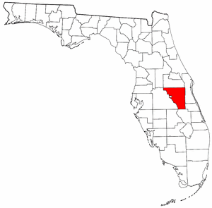
Osceola County, Florida
Success = Speed
New county administration team
  Inherited a program . . .
  New team was given 12 months to have 7 projects under construction or they would be replaced (Success = Speed?)
  Team turned to two methods they had never used:
    CM/GC project delivery and project bundling.
  Bundled 18 projects under 6 contracts.
  11 projects underway by deadline.
Source: FHWA
Notes:
Time: 1:00
Key message: Case study #1, additional successful project bundling definitions
Delivery: Read instructor notes
Background Information: Bridge Bundling Guidebook provides more detail
Interaction: lecture, ask question
Photo sources and permissions to use: FHWA, previously approved slide BBG.
The need in Osceola County was speed for economic/tourism needs.
Inherited a program . . .that had completed one highway project in 18 years, and that had over $1B in funds for improvements from six years of bond sales
This team was in a desperate situation to deliver a large program quickly and efficiently.
A new County Commission was elected that was weary of the team, was prepared to bring in another team to deliver the projects.
Project Bundling and CM/GC allowed the team to do what was though to be impossible
The effort was dubbed “The Osceola County Miracle”
The Public Works Administrator was named one of Engineering News Record’s Top 25 Newsmakers in the US for the year.
That team needed speed above all else and bundling helped provide it.

Slide 38
Erie County, NY
Success = Preventative maintenance activities by work type and location
Steel Repairs - $1M every 2 years
Deck Repairs - $1M every 2 years
Bridge Washing - $250K every 2 years
Deck Sealing - $200K per year (6-year cycle)
Source: FHWA
Notes:
Time: 1:00
Key message: Case study #2
Delivery: Read instructor notes
Background Information: Source is FHWA’s “Advanced Project Bundling,” Appendix C.
Interaction: lecture
Photo sources and permissions to use: FHWA, previously approved slide BBG.
Erie County includes the City of Buffalo, and this is a good example of an urban county using bundling to maintain their bridge assets.
Note the different work types.
Erie County uses a series of bridge bundling contracts to address preventive maintenance issues.
The bridges are bundled primarily by work type.
Location is also a consideration.
There are four types of bundled maintenance projects:
Steel repair projects,
Deck repair projects,
Bridge washing projects,
Deck sealing projects.
The contracts were assembled by the County Bridge Engineer.
Erie County relied on Federal funds to pay for 80 percent of the cost to complete the work.
The agency submitted a bridge preventive maintenance work plan to NYSDOT for consideration.
NYSDOT makes the determination on funding.

Slide 39
Northhampton County, PA
Success = Improve bridge conditions using private funds
Owns 119 bridges
Significant percent in poor condition
Estimated 20 years to replace
Public private partnership (P3)
$37.5M in construction paid over 12 years
$1M in maintenance for 10 years, beginning year 5
33 bridge replacements over 14 years
Source: FHWA
Notes:
Time: 1:00
Key message: Case study #3
Delivery: Read instructor notes
Background Information: Source is FHWA’s “Advanced Project Bundling,” Appendix C.
Interaction: lecture
Photo sources and permissions to use: FHWA, previously approved slide BBG.
Another local public agency example – Northampton County, PA
Northampton County owns 119 bridges, a large percentage were in poor condition.
It would have taken over 20 years to address all of their bridges in poor condition.
Some of these bridges were either closed or posted, affecting the local economy.
By using a P3, they were able to gain the efficiencies of bundling and spread the cost over 14 years, addressing many of their poor bridges at one time.
The P3 Builder will maintain the bridges over the 14-year period of the contract.

Slide 40
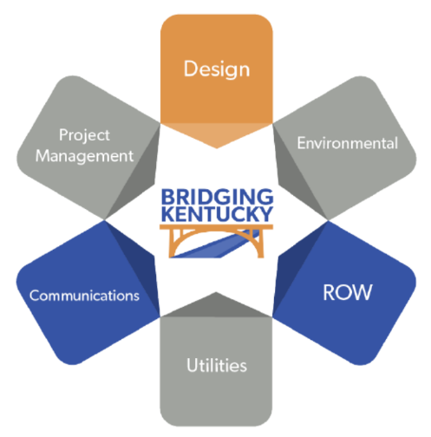
Bridging Kentucky
Success = Use innovation to improve local bridge conditions
Statewide Program
State, county, and municipal bridges
Estimated $700M over 6 years
Rehabilitate, repair, or replace bridges
District 5/6 Bundle
13 bridges bundled
4 bidders
$1.4M saved (14% under engineer’s estimate)
Design
Project Management
Environmental
Communications
ROW
Utilities
BridgingKentucky.com
Source: Kentucky Transportation Cabinet
Notes:
Time: 1:00
Key message: Case study #4
Delivery: Read instructor notes
Background Information: Source is FHWA’s “Advanced Project Bundling,” Appendix C.
Interaction: lecture
Photo sources and permissions to use: FHWA, previously approved slide BBG.
What if your goal was to integrate state, county, and municipal projects into one bundle?
Kentucky did.
Lessons Learned were abundant from this bundle:
Must be prepared and involve contractors
No one size fits all
Think of bundling beyond construction procurement
Bundling offers streamlined project development
Standardized design is a big benefit of bundling
Risk-based Geotech can be very helpful in a bundling contract
Expedited utility relocations CAN BE ACCOMPLISHED THROUGH BUNDLING
State funds can be used for ROW procurement
Bundling similar work pays numerous dividends

Slide 41

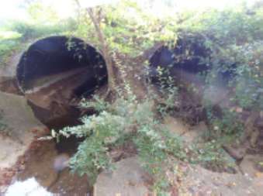
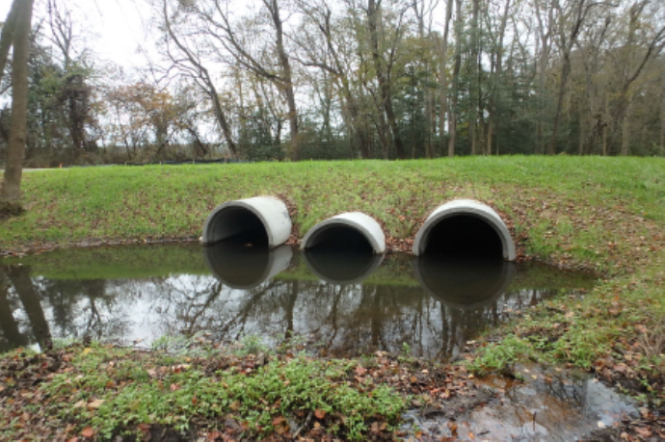
DelDOT Culvert Replacement Program
Success = Maximize flexibility to delivery systems and permitting
Years: 2006-Present
Cost: $1M-$3M/Year
Goal: Replace hundreds of culverts in poor condition
Bundled using D-B-B, IDIQ, and DB
Environmental permitting handled differently for each method
Source: FHWA
Notes:
Time: 1:00
Key message: Case study #5
Delivery: Read instructor notes
Background Information: Source is FHWA’s “Advanced Project Bundling,” Appendix C.
Interaction: lecture
Photo sources and permissions to use: FHWA, previously approved slide BBG.
In the early 2000s, DelDOT discovered a serious problem with deterioration of large pipe culverts.
Due to a decision made in the 1980s to remove them from the bridge inventory, hundreds of large culverts in poor condition had escaped inspection for decades.
DelDOT assessed the problem and began a bundling program to replace the culverts quickly.
More efficient environmental permitting and third-party coordination were major benefits of bundling
Small DBB bundles: Completed by DelDOT before advertisement.
Open-end (bundle) contract: (IDIQ) for additional locations, completed by DelDOT after procurement with input from the contractor.
D-B bundle: Third-party coordination is the responsibility of the contractor

Slide 42
Minnesota DOT
Success = Attain quick ADA compliance
ADA bundle project
$2.5M
200 +/-ramps and sidewalk
DB project delivery
  Integrate design and construction
  Better quality
Issues encountered
  Contractor not used to being prime
  Scoping RFP well without over specifying
Source: Accessible Curb Ramp, U.S. Access Board
Notes:
Time: 0:30
Key message: Case study #6
Delivery: Read instructor notes
Background Information: Source is FHWA’s “Advanced Project Bundling,” Appendix C.
Interaction: lecture
Photo sources and permissions to use: FHWA, previously approved slide BBG.
Sometimes a law is passed, and immediate compliance is demanded.
This is an example of a state addressing an issue almost every agency has to address – ADA compliance.
This is a work type that contractors can become very efficient at if quantities are large enough – resulting in lower cost.

Slide 43
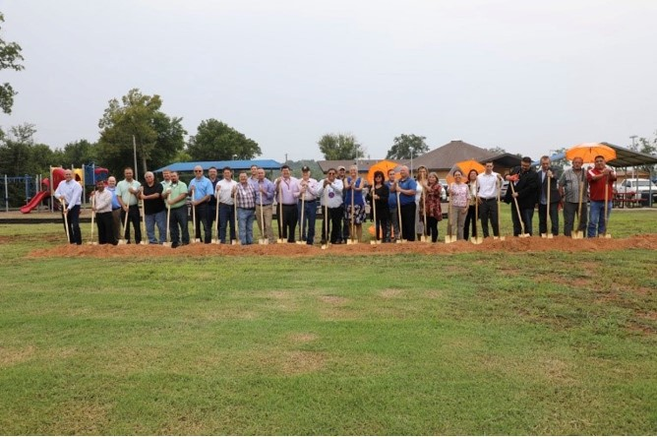
Pawnee Nation
Success = Maximum flexibility in combining vertical and horizontal construction
Pawnee – Groundbreaking same day as notice to proceed.
Vertical (HUD)
Horizontal (FHWA)
Vertical and Horizontal (Tribal and Disney Grant)
Source: Pawnee Nation
Notes:
Time: 1:30
Key message: Case study #7
Delivery: Read instructor notes
Background Information: Source is FHWA’s “Advanced Project Bundling,” Appendix C.
Interaction: lecture
Photo sources and permissions to use: FHWA, previously approved slide BBG; Pawnee Nation permission: Chris McCray cmccray@pawneenation.org.
The Native American people have fewer restrictions, based on sovereign immunity, on what they can do than government agencies, as such they often lead in adopting innovations such as project bundling.
Main objective was to solve the Tribe’s challenging problems with deadlines, limited staff, political pressure, differing project types, etc.
This is an example of a tribal nation using an alternative contracting method in conjunction with bundling for both horizontal and vertical projects.
Due to combining Project Bundling with the power of ACMs, the Pawnee may have some of the highest production rates in the nation.
The Pawnee tribe in Oklahoma combined Bundling with CM/GC, and amazingly broke ground on their bundle the day the Notice to Proceed was issued.
Besides using a delivery system that was new to them and combining vertical and horizontal construction in the same bundle, they also had projects funded by different sources within the same bundle.
This was the first time any agency had combined an ACM with Bundling in a contract that included both horizontal and vertical projects.
Vertical (HUD)
ICDBG Campgrounds and Fit Trail Project
Vertical & Horizontal (Tribal & Disney Grant)
Building 1 Roof Project
Building 1 Demo Project
Trading Post Roof Project
Roam Chief Porch Addition Project
Meet Me at the Park Project
Horizontal (FHWA)
1st Street Safety Project
Morris Rd. Project
Morris Rd. to Hwy 64/18 Project
Green Bridge Project
Fog Seal Project
Lights on Catlett Rd. Project
Directional Signage Project

Slide 44
Agenda item #5
Resources
Learning objective:
Identify project bundling resources.
Notes:
Time: 0:15
Key message: Begin agenda item #5, LO #4
Delivery: Read instructor notes
Background Information: Sponsored by FHWA, an EDC-5 innovation initiative
Interaction: lecture
Photo sources and permissions to use: n/a
Our fifth agenda item is identifying resources available to help you.
The associated learning objective is to be able to identify what those resources are and where you can find them.
This will be accomplished by highlighting these resources and where you can access them.
The FHWA Resource Center provides technical project bundling support for any organization that is considering bundling. This includes awareness and implementation training to leadership, staff, and stakeholders, helping to advance project bundling

Slide 45
Agency Self-Assessment Tool
Capability Level Criteria
Level | Description | EDC Definition | Definition applied specifically to bundling
1 | Not Implementing | The agency is not using the innovation anywhere and is not interested in pursuing the innovation. | Project bundling is not considered.
2 | Development Stage | The agency is collecting guidance and best practices, building support with partners and stakeholders, and developing an implementation process. | No formal policy, process or tools. Ad hoc approach to project bundling is applied when required.
3 | Demonstration Stage | The agency is testing and piloting the innovation. | Basic project bundling process and tools are repeatedly used but not standardized. Approach varies from project to project.
4 | Assessment Stage | The agency is assessing the performance of and process for carrying out the innovation and making adjustments to prepare for full deployment. | Draft organizational standard process for developing project bundling strategy is documented. Supporting methods, tools, and staff training are being assessed.
5 | Institutionalized | The agency has adopted the innovation as a standard process or practice and uses it regularly on projects. | Organizational standard process for developing project bundling strategy documented. Supporting methods, tools, and staff training are established and documented.
6 | Optimized | -not applicable- | Lessons learned and best practices are applied for continuous improvement. Performance metrics have been established to enable quantitative feedback.
Notes:
Time: 0:30
Key message: Project bundling agency self-assessment tool description
Delivery: Read instructor notes
Background Information: Tool, Advanced Project Bundling: Quick “Start Reference
Interaction: lecture, pause
Photo sources and permissions to use: FHWA, previously approved QSR, Self-assessment tool.
This tool does not measure the efficiency or quality of a bundling program—just the maturity of it.
These are the levels of maturity that an agency might find themselves in at any time in regard to project bundling.
These levels of maturity are defined here.
Instructor: Pause for several seconds to allow the students to read through the figure.

Slide 46
Agency Self-Assessment Tool
25 Practices
# | Practice
1 | Early bundling decision during planning/programming
2 | Determine optimum bundle size
3 | Limit bundle by work type
4 | Limit bundle by geographic proximity
5 | Outreach - Industry
6 | Outreach - stakeholders
7 | Local partnering
8 | Identify Federal-aid eligible work types
9 | Use innovative finance
10 | Use state funding only
11 | Bundle to reduce number permit actions
12 | Programmatic permit
# | Practice
13 | Assign permitting tasks to industry
14 | Consolidated utility agreement
15 | Assign utility coordination to industry
16 | Stage ROW acquisition sequence
17 | Use IDIQ to stage ROW/permits/utilities
18 | Assign ROW tasks to industry
19 | Use ACM
20 | Use ATC
21 | Coordinate construction staging
22 | Coordinate MOT
23 | Progressive GMP
24 | Open-end contract
25 | Use IDIQ for emergency contracts
Notes:
Time: 0:30
Key message: Project bundling agency self-assessment tool practices
Delivery: Read instructor notes
Background Information: Tool, Advanced Project Bundling: Quick “Start Reference
Interaction: lecture, pause
Photo sources and permissions to use: FHWA, previously approved QSR, Self-assessment tool.
These are the 25 practices by which an agency can evaluate the maturity of their project bundling processes.
Please note that it is rare for an agency to use all 25 practices, in part because they may not have legislative approval to use some of them.
Again, this is not a checklist that measures success for the bundle; it measures the maturity of the bundling program.
As such, an agency can be extremely successful without using all these practices.
The tool is set up such that the agency can evaluate the practices that are most appropriate for them – the first four are minimally required.
The tool not only enables an organization to determine where they are with each practice, but to also identify those practices that they would like to advance to a higher maturity level.
End product is an action plan showing current state, desired state, and actions/steps to get there.
Instructor: Pause for several seconds to let the students read the practices.

Slide 47
Project Bundling Resource Database
Case Studies
Contracts
References
Research
https://www.fhwa.dot.gov/innovation/everydaycounts/edc_5/project_bundling.cfm
Notes:
Time: 1:00
Key message: Project bundling resource database decription
Delivery: Read instructor notes
Background Information: Database, Advanced Project Bundling: Quick “Start Reference
Interaction: lecture, pause
Photo sources and permissions to use: n/a
This database captures project bundling related information, the “how, why, and by what means,' to assist agencies and others in the development of project bundling contracts and programs.
This database was created as part of the Federal Highway Administration's Every Day Count Five (EDC5) Project Bundling innovation initiative.
This database is divided into four categories:
Case Studies
Contracts
References
Research
Case Studies - The Case Studies component of this database includes state and local agency bundling projects. These case studies cover a variety of work types, project delivery systems, funding mechanisms, and scope (local to statewide).
Contracts - The Contracts component provides a summary of actual project bundling contracts with links to contract documents.
References - The Reference component includes project-bundling-related guidance from the Federal Highway Administration, State Department's of Transportation, Local agencies, and others.
Research - The Research component provides a summary of project-bundling-related academic and agency-sponsored research related to project bundling.
How to use - Tabs can be searched by key words, sorted by columns, or by project bundling practice (the 25 practices are defined in the Federal Highway Administration's Project Bundling Self-Assessment tool - see the Reference tab for link to the tool).

Slide 48
Case Studies (1 of 2)
Bundling scope of work for
Preservation/Preventive maintenance
Rehabilitation
Replacement/New
Funding and financing by
Federal funds
State funds
Local funds
Private sector
Bundled by
State owners
Local owners
Combined owners (State & Local)
Notes:
Time: 1:00
Key message: Project bundling resource database case study tab description
Delivery: Read instructor notes
Background Information: Database, Advanced Project Bundling: Quick “Start Reference
Interaction: lecture, pause
Photo sources and permissions to use: n/a
Numerous case studies have been prepared documenting how different agencies have used project bundling, these case studies cover,
This is how the Case Studies are documented and stored.
Different work types
Different funding sources (funding sources often dictate the process and rules and regulations to be followed)
Different owners – state level, local level, and combined efforts.
Instructor: Pause for several seconds to let the students read the slide.

Slide 49
Case Studies (2 of 2)
Project Delivery by
Design-Bid-Build
Indefinite Delivery/Indefinite Quantity
Construction Manager/General Contractor
Design-Build
Public-Private Partnerships (Design-Build-Finance-Operate)
Procurement by
Low Bid
Best Value
Qualifications-Based Selection
Notes:
Time: 1:00
Key message: Additional project bundling resources database case study tab description
Delivery: Read instructor notes
Background Information: Database, Advanced Project Bundling: Quick “Start Reference
Interaction: lecture, pause
Photo sources and permissions to use: n/a
Case Studies are also categorized and stored according to:
Project delivery methods
Procurement methods (although not covered in this lecture, the procure methods listed here can be combined with the delivery methods above) – all these procurement methods have been used successfully for project bundling.
The case studies can be found in the BBG, QSR, and on FHWA’s website.
Instructor: Pause for several seconds to let the students read the slide.

Slide 50
Webinar Series
Series 1:
Advanced Project Bundling:
Examples Beyond Bridges
Key Characteristics of Lead Agencies
Making the Business Case
Project Bundling for Local Public Agencies
How To
Overcoming Hurdles
Series 2:
A Strategic Approach to Project Bundling:
What Does Success Look Like?
The Business Process
Planning and Capital Programming
Preconstruction
Local Agency Partnering
Construction and Contract Considerations
https://www.fhwa.dot.gov/ipd/alternative_project_delivery/defined/bundled_facilities/webinar_series.aspx
Notes:
Time: 0:30
Key message: Project bundling agency webinar series decription
Delivery: Read instructor notes
Background Information: Webinar series on-demand recordings
Interaction: lecture, pause
Photo sources and permissions to use: n/a
These recordings are available on-demand on FHWA EDC5 Project Bundling Website.
Instructor: Pause for several seconds to let the students read the slide.

Slide 51
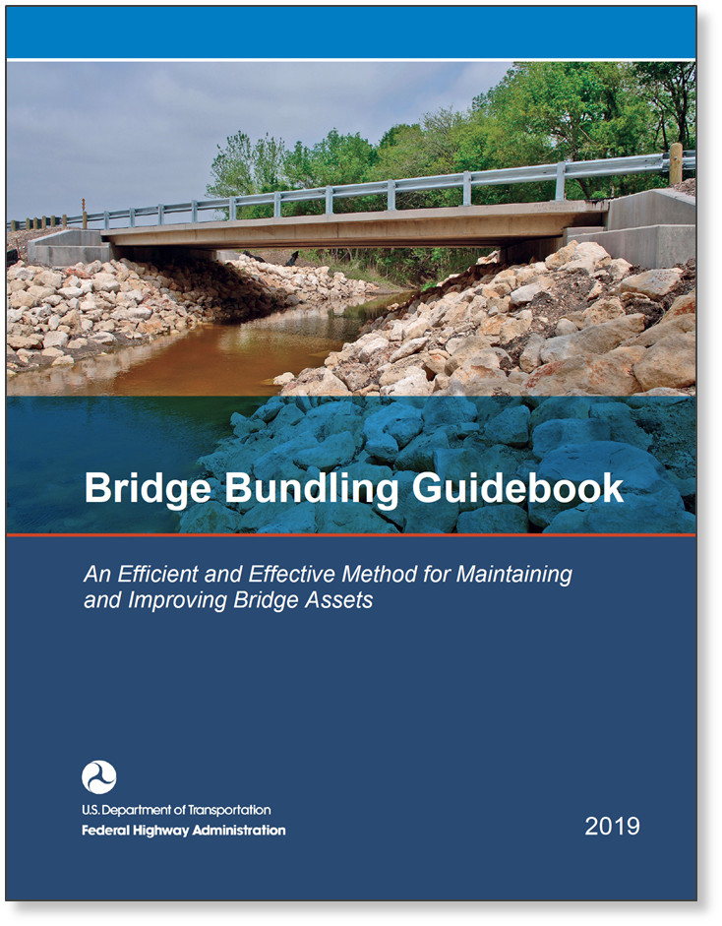
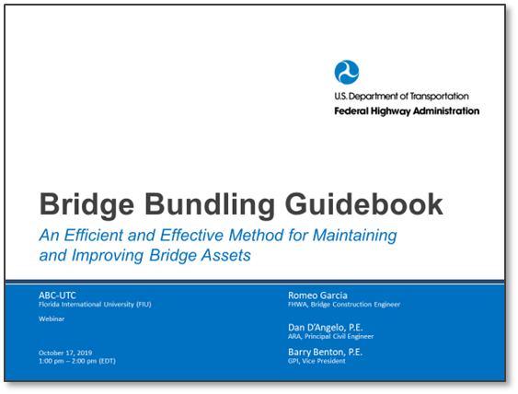
Bridge Bundling Guidebook
Available for download at:
https://bit.ly/FHWA_BBG
Notes:
Time: 0:30
Key message: Bridge Bundling Guidebook description
Delivery: Read instructor notes
Background Information: Bridge Bundling Guidebook
Interaction: lecture
Photo sources and permissions to use: n/a
The Bridge Bundling Guidebook is an excellent source of information.
An overwhelming majority of this book is totally applicable to project types other than bridges.
Much of this lecture was based on the content of this document – you will find additional details on many of the topics covered in this lecture in this publication
As shown by the image on the right hand of this slide, a complimentary PowerPoint providing an overview of the Guidebook is also available.

Slide 52





Guidebook Content
Federal legislation
Noteworthy practices from agencies, including case studies
Other resources from agencies or professional organizations
Federal guidance
Video clip from State or local agency representative offering his or her perspective
Source: FHWA Bridge Bundling Guidebook
Notes:
Time: 0:30
Key message: Additional Bridge Bundling Guidebook description
Delivery: Read instructor notes
Background Information: Bridge Bundling Guidebook
Interaction: lecture
Photo sources and permissions to use: n/a
Throughout the Guidebook, these symbols are used to draw the reader’s attention to links to five valuable types of information:
Legislation,
Noteworthy practices, and case studies,
Other federal guidance,
Video/audio clips from owners and other subject matter experts.

Slide 53

Training
CENTER FOR
LOCAL AID SUPPORT
Online Training Library
PROJECT BUNDLING
Project Bundling Series – Course 1: Fundamentals
Project Bundling Series – Course 2: Staging the Bundle
Project Bundling Series – Course 3: Creating and Contracting the Bundle
https://www.fhwa.dot.gov/clas/ttap/online_training.aspx
Notes:
Time: 0:15
Key message: Online training for the Project Bundling (intended audience is local public agencies)
Delivery: Read instructor notes
Background Information: FHWA CLAS ‘Bridge Bundling’ web training Interaction: lecture
Interaction: lecture
Photo sources and permissions to use: FHWA
For more in-depth training on Project bundling, FHWA has created a three-part course based on the Bridge Bundling Guidebook.
It is free.
It is interactive.
Although intended audience is local public agencies, it is appropriate for any agency or any civil engineering student to learn more.

Slide 54
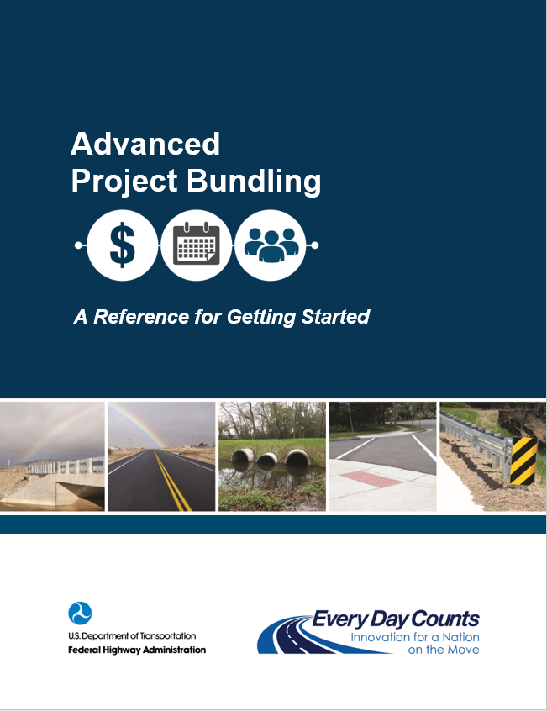
Table of Contents
1. Basis for Advanced Project Bundling
2. Advanced Project Bundling Practices
3. Initial Implementation Steps
4. Getting Started: Planning and Funding
5. Process and Procedures for Selecting
Bundled Projects
6. Final Steps for Most Effective Bundling
Notes:
Time: 0:30
Key message: Advanced Project Bundling: A Reference for Getting Started description
Delivery: Read instructor notes
Background Information: Advanced Project Bundling: A Reference for Getting Started
Interaction: lecture, pause
Photo sources and permissions to use: FHWA
A more recent publication is the “Advanced Project Bundling: A Reference for Getting Started” – a quick start reference.
This, too, is an excellent resource. This reference document on Advanced Project Bundling supplements the BBG with additional information on bundle creation and process details.
Table of Contents is shown on the right.
Several appendices provide additional information on,
Appendix A. Case Studies
Appendix B. Project Groupings by Type in Transportation Improvement Programs
Appendix C. Organizational Self-Assessment
Appendix D. Project Bundling Policy and Process Checklist
Appendix E. Project Bundling Risk Management
Appendix F. Additional Resources – Database
Appendix G. Indiana Department of Transportation Project Bundling Business Rules (Draft)
A complimentary PowerPoint providing an overview of the Reference is also available.
Instructor: Pause for several seconds to let the students read the slide.

Slide 55
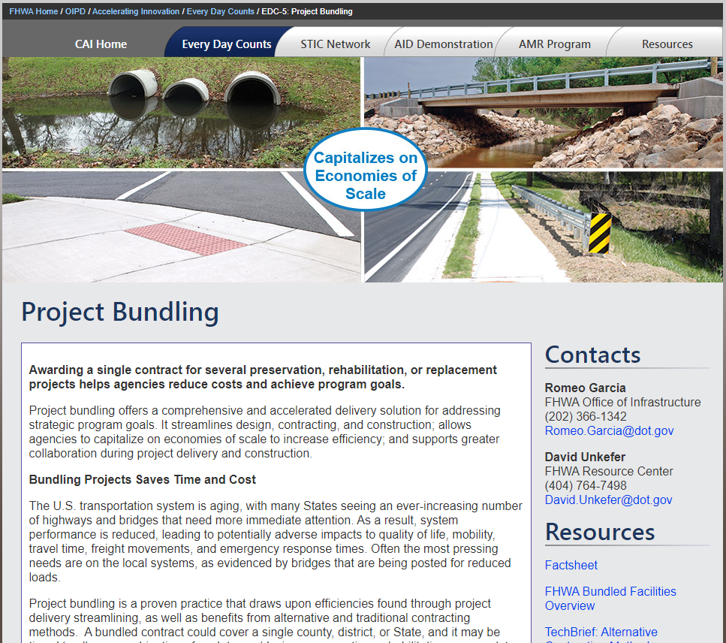
FHWA EDC-5 Website
Search for
“FHWA EDC-5”
https://www.fhwa.dot.gov/innovation/everydaycounts/edc_5/project_bundling.cfm
Notes:
Time: 0:15
Key message: FHWA EDC5 Project Bundling website description
Delivery: Read instructor notes
Background Information: website
Interaction: lecture
Photo sources and permissions to use: FHWA
The Every Day Counts website is continually updated with new information regarding many initiatives, including Project Bundling.
This website includes links to all the reference material described in the agenda item and referenced throughout the lecture.

Slide 56
Learning Objectives Recap
Define what is project bundling.
Understand why agencies bundle projects.
Describe how agencies create project bundles.
Apply and evaluate project bundling.
Identify project bundling resources.
Notes:
Time: 2:00
Key message: Project Bundling learning objective summary/recap
Delivery: Read instructor notes
Background Information: This PowerPoint/ lecture
Interaction: lecture
Photo sources and permissions to use: n/a
Recapping our four learning objectives….
1. We begin with defining the concept of project bundling – what is it –
a) “a process by which a single contract award is used to deliver multiple projects. “
2. Second, we developed an understanding of why agencies bundle projects –
a) to achieve the goals and objectives defined by the agency.
b) to take advantage of the efficiencies inherent in bundling – cost , savings and resources
c) to take advantage of the many other agency objectives
3. Third, we went through the 10 process steps necessary to create a successful bundled project – the how -
Define successful project bundling
Determine goals & objectives for the bundle
Identify funding or financing for the bundle
Build a coalition & outreach to inform and train about bundling
Perform risk assessment on proposed bundles
Select projects for the bundle
Select delivery system for the bundling contract
Determine environmental review & preliminary design considerations for the proposed bundle
Bundle & let contract(s)
Conduct quality assurance, close-out & celebrate!
4. For our fourth learning objective, we then went through 7 case studies that demonstrated the how and why of successful bundled projects delivered by local public agencies, by state DOT’s by state and local agencies working together, by different work types.; and
5. For the fifth learning objective we discussed several resources available to transportation infrastructure asset owners and those involved in project bundling contracts to create project bundles and to incorporate the practice into their business processes., this includes,
a) an agency self-assessment tool, that evaluates 25 practices to determine the level of maturity they are at and to identify improvement opportunities
b) a project bundling resource database of case studies, bundling contract, resources, and research studies.
c) an on-demand webinar series of 12 bundling topics
d) the Bridge Bundling Guidebook
e) an online training course, tailored for local public agencies
f) An Advance Project Bundling: a Reference for Getting Started
g) FHWA’s Project Bundling website
h) and, other resources are being developed, such as how-to guides addressing specific I topic in more detail

Slide 57
Key take-aways?
Questions?
Notes:
Time: 4:00
Key message: Student questions and take-aways
Delivery: Read instructor notes
Background Information: This PowerPoint/ lecture
Interaction: lecture, question
Photo sources and permissions to use: n/a
Ask students for their biggest takeaway.
Ask students if there any questions?
Prompt students by mentioning issues/risks related to bundling.
Next; an opportunity to apply what you have learned in this lecture by using a fictitious agency’s data to identify project bundles to achieve a specific goal.

Slide 58
Activity – Create a Bundle
Handout - a list of projects with key information about each and instructions.
Work in teams and use the information you learned in this lecture to identify potential project bundles.
Notes:
Time: 4:00; homework
Key message: Student activity – creating a bundle
Delivery: Read instructor notes
Background Information: Class handouts
Interaction: instructor provides homework instruction - small group activity, determine bundle, provide justification, instructor review/grading
Photo sources and permissions to use: n/a
Great! Now we have a little exercise that you will all take part in.
This will be a team exercise; assign teams or ask to select their own teams of 3-5 people.
Provide one of the exercises to each team.
Each team will be given detailed descriptions of two scenarios involving an agency in need of executing several construction projects.
Given the details of each scenario, and the information you’ve been given regarding the practice of Bundling, each team will generate a recommendation for how to bundle the projects in each scenario.
Each recommendation must be supported with the thought process and reasoning behind the recommended bundles.
You may use the lecture (PowerPoint) notes, any notes that you took during the lecture, and any of the outside resources described in the lecture.
Instructor: Give students time to review assignment and ask questions.

